Slide 1
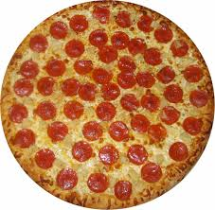
It’s Pizza Time!
You ate 1 slice of pizza.
Your friend ate 2 slices of pizza.
Who ate the most pizza?
?

Slide 2
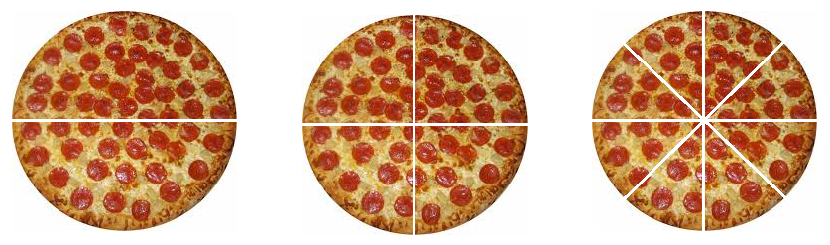
Wait!
The answer may not be what you think!
In order to answer the question, you need to know how big the slices are and how many slices are in each pizza.
Let’s take a look at this again!

Slide 3
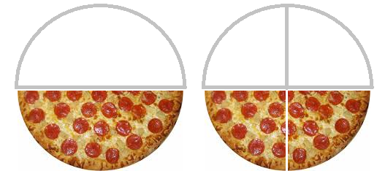
What if you ate 1 out of 2 pieces and
your friend ate 2 out of 4 pieces?
You ate 1 out of 2.
Your friend ate 2 out of 4.
The number of slices is different,
but the amount of pizza is the same!

Slide 4
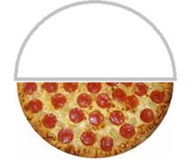
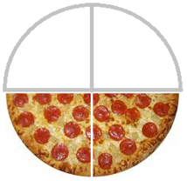
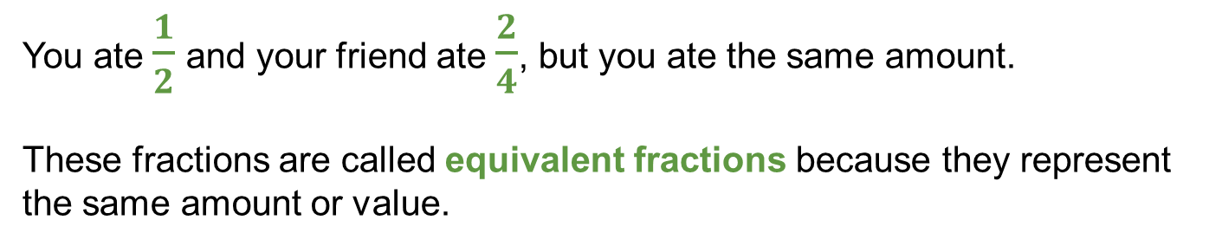
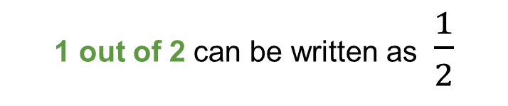

You can use a fraction to represent how much pizza each of you ate.
1 out of 2 can be written as $\frac{1}{2}$
equivalent fractions
2 out of 4 can be written as $\frac{2}{4}$
You ate $\frac{1}{2}$ and your friend ate $\frac{2}{4}$, but you ate the same amount.
These fractions are called equivalent fractions because they represent the same amount or value.

Slide 5
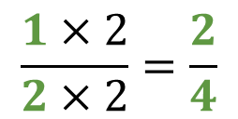
To write an equivalent fraction, multiply the numerator and denominator by the same number.
$\frac{1}{2} \frac{2}{4}$
numerator
denominator
$$\frac{1×2}{2×2}=\frac{2}{4}$$
same value times both numerator and denominator

Slide 6
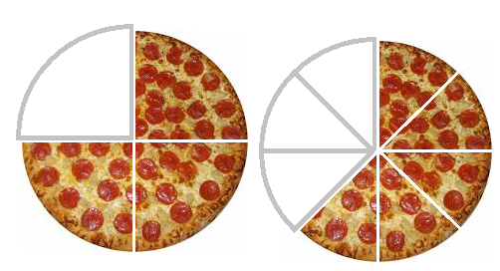

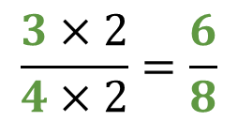

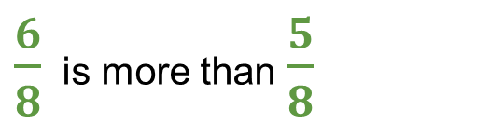

To compare fractions with different denominators, write equivalent fractions with the same denominator.
$$\frac{3}{4}$$
$$\frac{5}{8}$$
$$\frac{3×2}{4×2}=\frac{6}{8}$$
$$\frac{5}{8}$$
$\frac{6}{8}$ is more than $\frac{5}{8}$

Slide 7
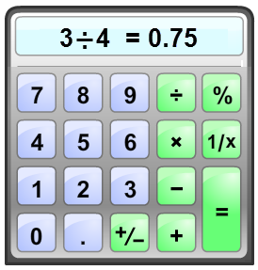
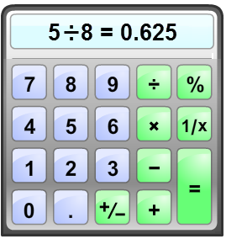
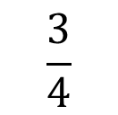
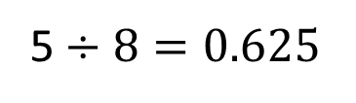
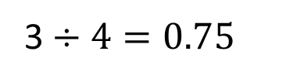
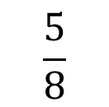
You can also compare fractions by dividing to write them as decimals.
$$\frac{3}{4}$$
$$\frac{5}{8}$$
The fraction bar means division.
3$÷4=0.75$
5 $÷8=0.625$
Notes:
Not cute or motivating and not quite sure what it was. Add a small cute cartoony calculator graphic instead?

Slide 8
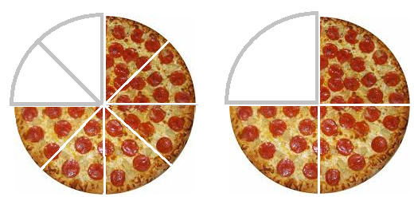


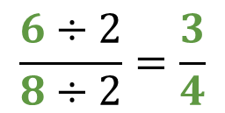
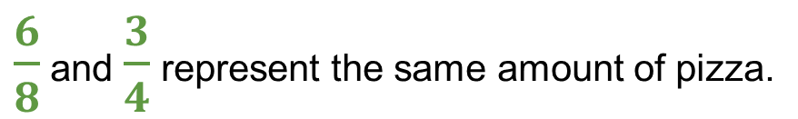

Another way to compare fractions is to write them in lowest terms. To write in lowest terms, divide the numerator and denominator by the same number.
$$\frac{6}{8}$$
$$\frac{3}{4}$$
$$\frac{6÷2}{8÷2}=\frac{3}{4}$$
$$\frac{3}{4}$$
$\frac{6}{8}$ and $\frac{3}{4}$ represent the same amount of pizza.

